Slide 1
MaldoNetB0 - Enhanced EfficientNetB0 for Disease Detection in Apple (Malus domestica) Using Optuna with Bayesian Optimization (TPE)
PIP2001 Capstone Project
Review-3
Batch Number: PSCS235
Roll Number | Student Name
20211CSE0355 | UDEEP S LOKESH
20211CSE0263 | ANIKA NAYAK
20211CSE0381 | SHREYAS D M
20211CSE0231 | SHREEBHUVAN SR
Under the Supervision of,
Ms. Tintu Vijayan
Assistant Professor
School of Computer Science and Engineering
Presidency University
Name of the Program: CSE
Name of the HoD: Dr. Asif Mohammed H.B
Name of the Program Project Coordinator: Mr. Amarnath J.L & Dr. Jayanthi. K.
Name of the School Project Coordinators: Dr. Sampath A K / Dr. Abdul Khadar A / Mr. Md Zia ur Rahman

Slide 2
Introduction
The developed study enhances plant leaf disease detection using EfficientNetB0 for feature extraction and Optuna for hyperparameter tuning.
With techniques like early stopping and learning rate scheduling, the optimized MaldoNetB0 achieved 97.37% training accuracy and 98-99% validation accuracy in 15 epochs, alongside an AUC of 0.9998.
Early stopping was done to avoid overfitting, Learning rate scheduling allowed the model to smoothly converge
This scalable approach offers significant potential for agriculture and crop management.

Slide 3
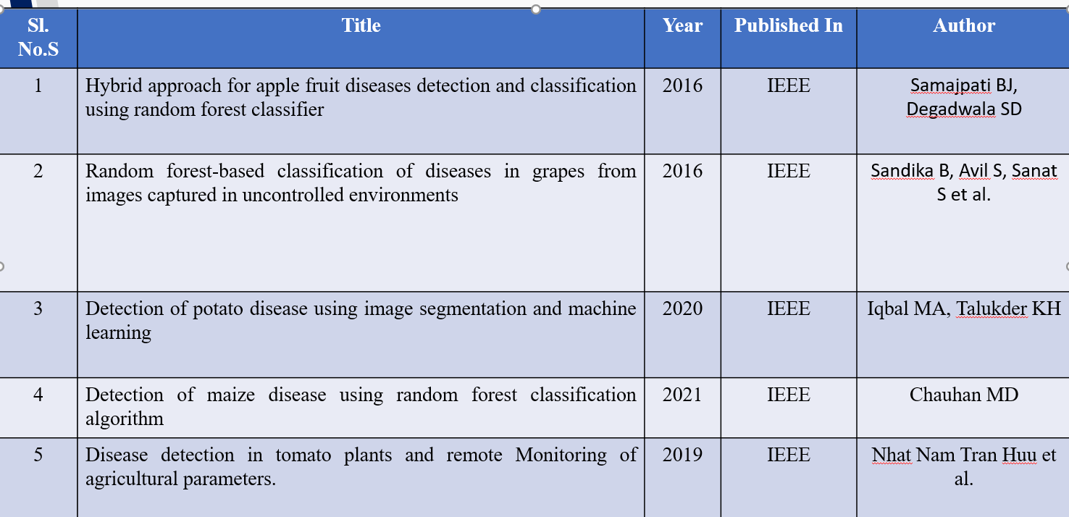
Literature Review

Slide 4
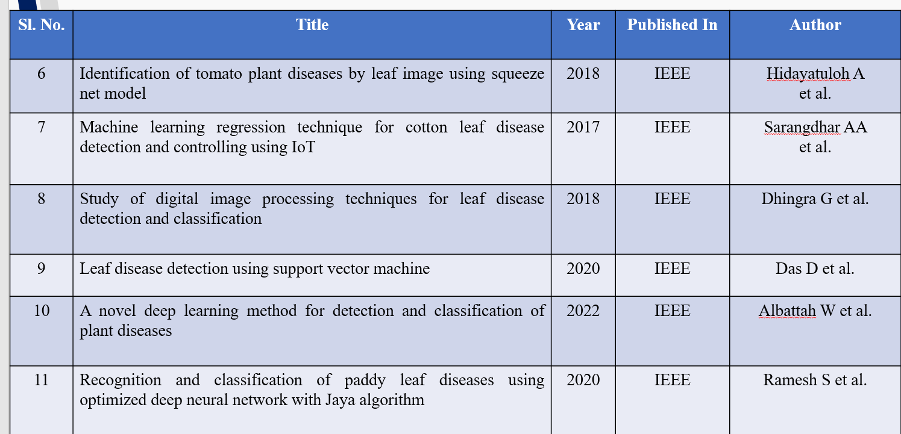
Literature Review

Slide 5
Methodology
Data Cleaning
Data Normalization
Data Augmentation
Data Optimization
CNN-based methods

Slide 6
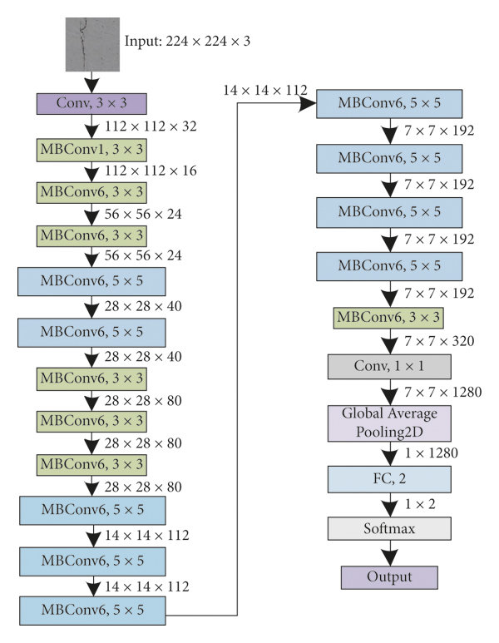
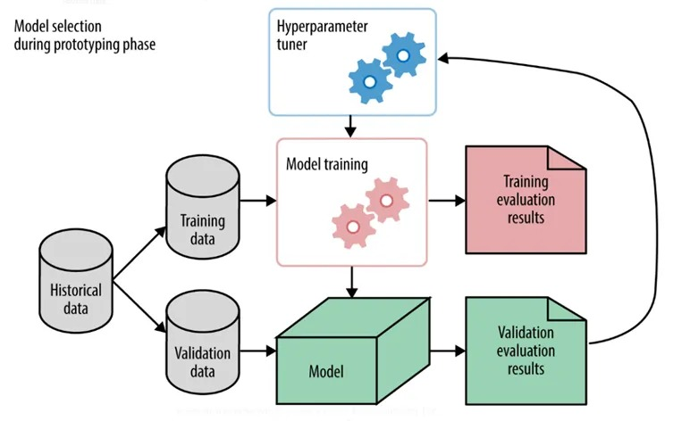
Architecture
EfficientNetB0 architecture
Optuna architecture

Slide 7
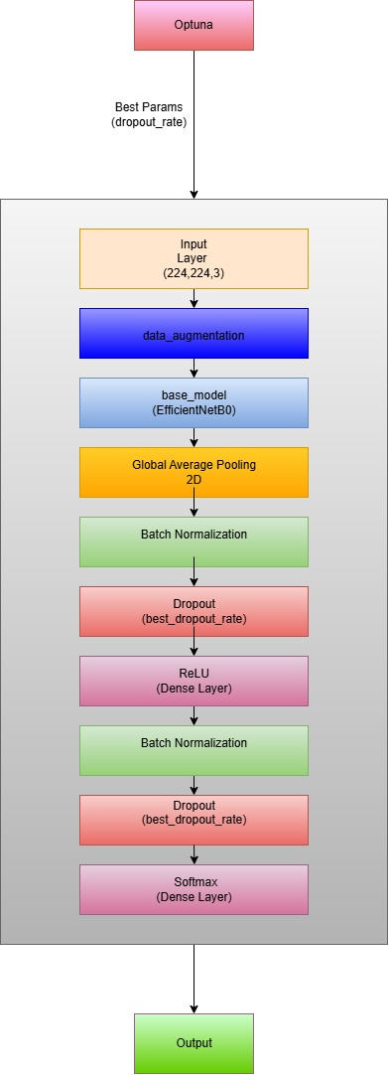
Architecture
MaldoNetB0 Architecture

Slide 8
Steps perform by Optuna
Suggest Hyperparameters
Build and Train the Model
Evaluate the Model
Update the Search
Iteration
Retrieve Best Hyperparameters

Slide 9
Uses of EfficientNetB0
High Accuracy with Efficiency
Good for Image Classification and Feature Extraction
Scalable Architecture
Good performance
Best for classification

Slide 10
Proposed Method
Hyperparameter Optimization with Optuna
Base Model: EfficientNetB0
Custom Layers
Training and Validation
Final Model: MaldoNetB0

Slide 11
Objectives
Advancements in plant disease detection face critical challenges:
Visual Similarity Between Classes
Imbalanced Data Distribution
Lack of Robust Hyperparameter Tuning
Scalability for Real-World Applications
Addressing these challenges is crucial for building reliable, scalable, and efficient disease detection systems

Slide 12
Conclusion
Introduced MaldoNetB0, a deep learning model for apple leaf disease detection using EfficientNetB0 and Optuna optimization.
Achieved over 98% validation accuracy and an AUC of 0.9998, demonstrating high predictive performance.
Enables early disease detection, minimizing crop losses and enhancing yield.
Future scope: expand to other crops, integrate IoT for real-time monitoring, and develop scalable precision agriculture solutions.

Slide 13
References
[1] Samajpati BJ, Degadwala SD (2016) Hybrid approach for apple fruit diseases detection and classification using random forest classifier. In: 2016 International conference on communication and signal processing (ICCSP). IEEE, pp 1015–1019.
[2] Sandika B, Avil S, Sanat S, Srinivasu P (2016) Random forest-based classification of diseases in grapes from images captured in uncontrolled environments. In: 2016 IEEE 13th international conference on signal processing (ICSP). IEEE, pp 1775–1780.
[3] Zawbaa, HM, Hazman M, Abbass M, Hassanien AE (2014) Automatic fruit classification using random forest algorithm. In: 2014 14th International conference on hybrid intelligent systems. IEEE, pp 164– 168.
[4] Iqbal MA, Talukder KH (2020) Detection of potato disease using image segmentation and machine learning. In: 2020 International conference on wireless communications signal processing and networking (WiSPNET). IEEE, pp 43–47.
[5] Chauhan MD (2021) Detection of maize disease using random forest classification algorithm. Turkish J Comput Math Educ (TURCOMAT) 12(9):715–720.
[6] Deepak AH, Gupta A, Choudhary M, Meghana S (2019) Disease detection in tomato plants and remote Monitoring of agricultural parameters. In: 2019 11th International conference on advanced computing (ICoAC). IEEE, pp 28–33.
[7] Hidayatuloh A, Nursalman M, Nugraha E (2018) Identification of tomato plant diseases by leaf image using squeeze net model. In: 2018 International conference on information technology systems and innovation (ICITSI). IEEE, pp 199–204.
[8] Sarangdhar AA, Pawar VR (2017) Machine learning regression technique for cotton leaf disease detection and controlling using IoT. In: 2017 International conference of electronics, communication and aerospace technology (ICECA), pp 449–454. https://doi.org/10.1109/ICECA.2017. 8212855
[9] Dhingra G, Kumar V, Joshi HD (2018) Study of digital image processing techniques for leaf disease detection and classification. Multimedia Tools Appl 77(15):19951–2000
[10] Das D, Singh M, Mohanty SS, Chakravarty S (2020) Leaf disease detection using support vector machine. In: 2020 International conference on communication and signal processing (ICCSP). IEEE, pp 1036–1040

Slide 14

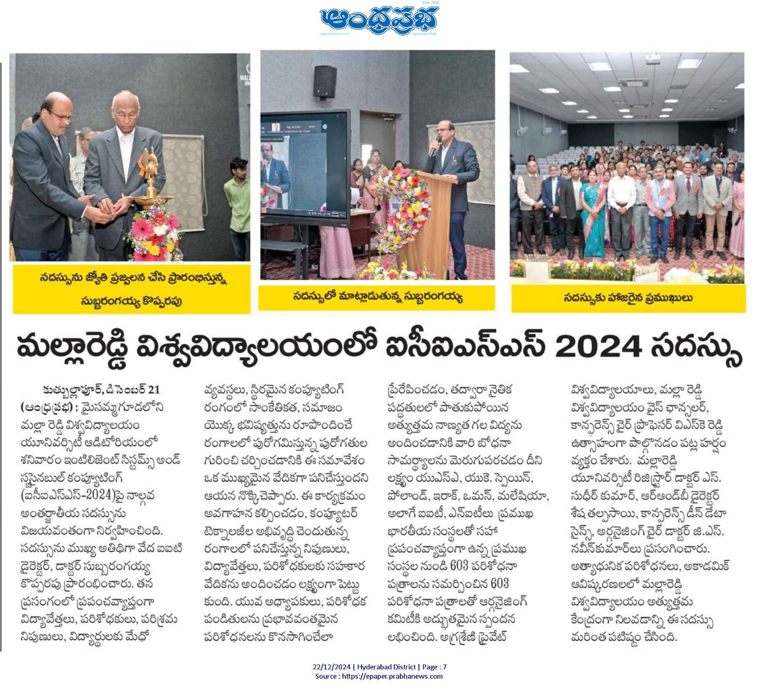
Publication Details

Slide 15
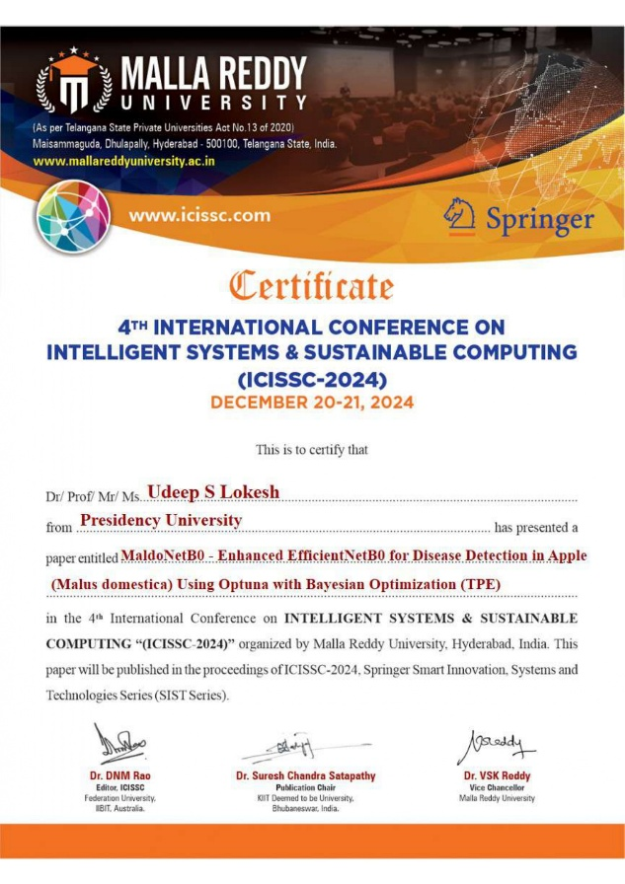
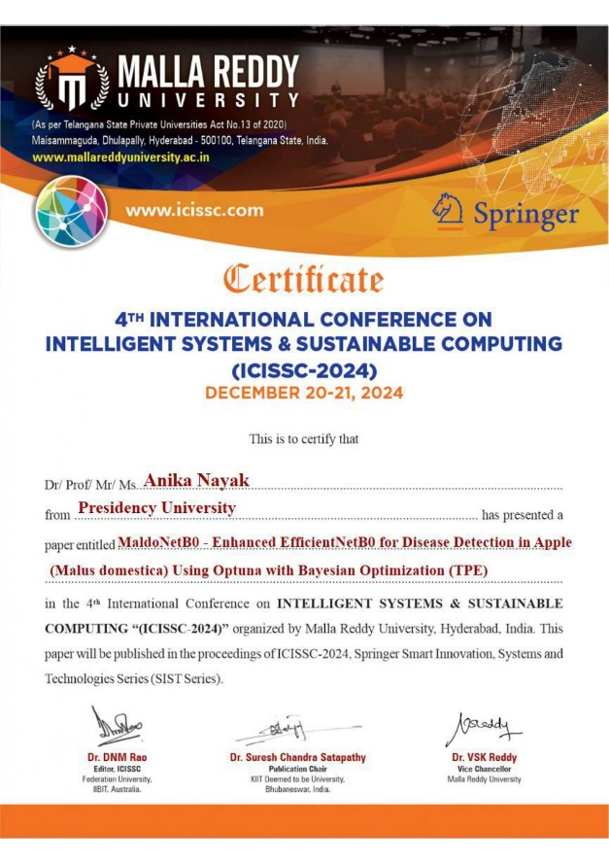


Achievements

Slide 16
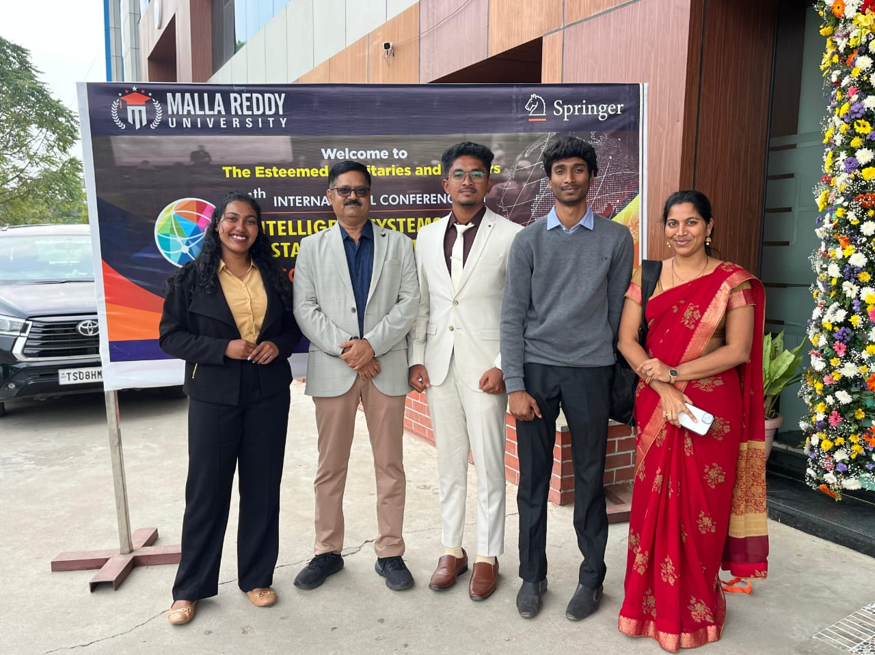
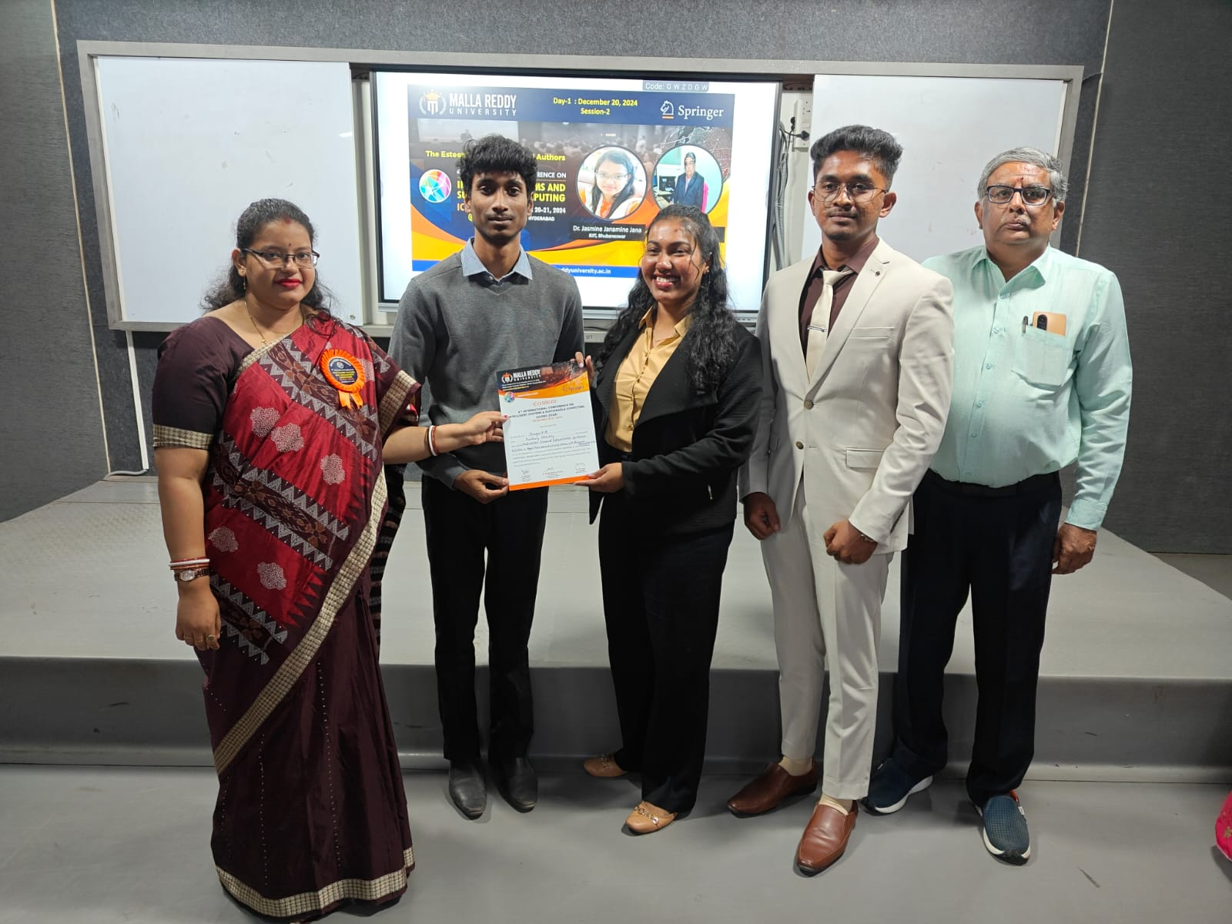
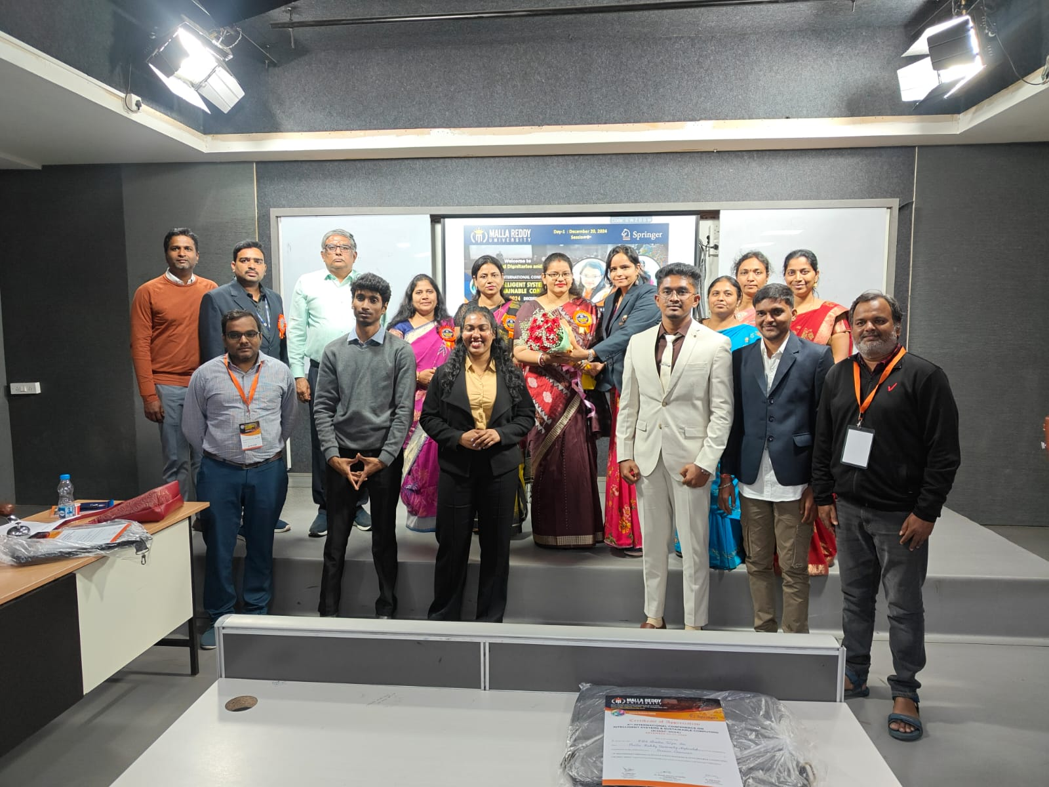
Achievements

Slide 17
Thank You

